Slide 1






Lectures on
Quantum Machine Learning
Junyu Liu 2022 @ Argonne Lab

Slide 2





Worldline of Junyu Liu
2021-now
Chicago-IBM
Postdoc Scholar
1995
Born
2012-2016
Univ. of Sci & Tech of China
Bachelor of Science
2016-2021
California Institute of Technology
Ph.D in Physics
Notes:
https://www.idc.com/getdoc.jsp?containerId=prUS48414121
Might try a bottoms up approach, there are xx number of companies in molecular simulations, here is why we can help them
Who are the people working on them, who could be buyers and users in the company (crunchbase, pitchbook, IBIS provides research on different industries)
What startsup are catering to the pharma industry, finance industry.
Define our market within the problem instead of the industry

Slide 3
Lectures on
Quantum Machine Learning
Outline:
1). Quick introduction to QIS.
2). Variational Based QML.
3). Quantum kernel method.
4). Quantum neural tangent kernel.

Slide 5
Hilbert Space (physics):
A linear space that allows inner products. Could be either finite or infinite dimensional.
Usually for n-qubit system:
Quantum States:
Vectors living in

Slide 6
Dirac notations:
basis expansion
Dual space:
Inner products:
Observables and measurements:
Observables are Hermitian matrices in
When we “measure” some observables in some quantum states, we could observe their eigenvalues.

Slide 7
Born rule:
Decompose the observable into the eigenspace.
For an arbitrary quantum state, we have
The Born rule means that we will have the probability to obtain
when we measure the observable . The expectation value is

Slide 8
Existence of entanglement:
Consider the Bell state:
This describes entanglement.

Slide 9
Quantum computing:
Evolution of quantum states is given by unitary operators.
Quantum computing realizes an arbitrary unitary operator using
a small set of universal gates.
Quantum computing could be exponentially faster than classical ones: e.g. Shor’s algorithm on factoring large numbers.
Pauli matrices:
Pauli group:
Elements are with the form:

Slide 11
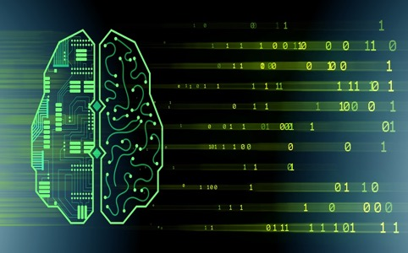
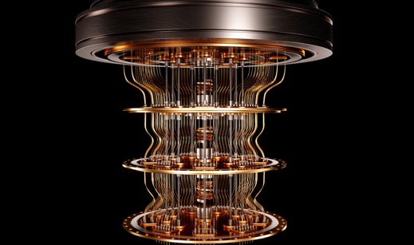
Quantum Machine Learning is an area in development, promising but blurred.

Slide 12
Big-picture problems
What is quantum machine learning(QML)?
Why QML, and where is the advantage?
What are the typical problems for QML?
What is the quantum database for QML?
What are the QML algorithms?

Slide 13
Variational Quantum Algorithms (VQA)
Example: variational quantum eigensolver (VQE).
NISQ quantum computational chemistry.
Quantum neural networks. (Peruzzo etc, 13, Farhi, Neven, 18)
EG:

Slide 14
Gradient descent algorithm

Slide 16
Linear model:
K: positive semidefinite and symmetric/Hermitian.
Theta: trainable parameters.
K defines a linear space with an inner product. There
is a unique dual “abstract”Hilbert space for a given K.

Slide 17
Representer theorem (informal):
For arbitrary non-linear function we want to learn, there
always exists a kernel established with a Hilbert space in
high dimensions, such that the function is learnable.
Thus, kernel method could be as universal as usual neural
networks.

Slide 18
Eg. Gaussian kernel:
Homework: prove that the Gaussian kernel is
positive-semidefinite and symmetric.

Slide 19
In quantum computing, the “abstract”Hilbert space
(linear space with inner product) could be naturally the
physical Hilbert space.
Homework (hard): prove both of the kernels are
positive-semidefinite and symmetric (Hermitian).

Slide 21
QNTK

Slide 22
ML problem : NTKs from number to matrix
QNTK

Slide 23
QNTK is an emergent kernel during gradient
descent.
It is positive semidefinite and symmetric. (homework)
It is generically changing during gradient descent dynamics.
In the limit where kernels are almost constants, we get predictable dynamics of gradient descent.

Slide 24
See references

